Slide 1


SAP UI5 & FIORI with OData TRAINING using BAS
Shekhar Vedi
Day – 8

Slide 2

Agenda – Day 8
Introduction to List controls in SAP UI5
Types of List in UI5
Creating model in Manifest.json
Search Functionality
List Modes and Grouping
Header and Footer Toolbar
Worklist Application
Split App Container
Loading Empty view at Start
common Issues in our app
Introduction to Router
Routing Configuration
Route Match Handler

Slide 3
Structure of a Fiori App
There are different folders and directory are required for setup project: webapp, Controller, models, utils ,view, Component.js, manifest.json, index.html
Structure of normal ui5 application
Index.html
View
Controller
Structure of Fiori Application
Dev.
sap/ui/core/UIComponent
Index.html
Root View
App.view.xml
Component.js
View 1
Controller 1
Container
App (pages)
View 2
Controller 2
manifest.json
App descriptor
App.controller.js
BaseController
Component.js is starting point

Slide 4
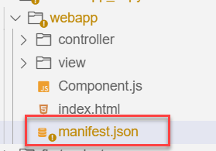
Manifest.json file
manifest.json is also knows as application descriptor file. When someone look at my application, my application descriptor will express all the necessary properties.
It contains all the configuration for our application.
manifest.json is a file which contains all the properties and initialization of our app. When app starts SAPUI5 framework will read this file and generate necessary artefacts out-of-box for us.
It is written in JavaScript Object Notation (JSON) format.
Reasons why we need manifest:
Once upon a time, I was in goa and enjoying my drink on beach, suddenly my phone rings and guess who is on the other side? You have developed a Fiori app last week and left for vacation, today we have a customer ticket and I am sitting with one your colleague, unable to understand what you did? Can you come and connect for some time.
A team member is leaving our team, he/she has developed 20 Fiori apps and now you suppose to take handover, she/he is not cooperating because they leaving, how will you hold on to the code?
SAP Delivers 1000s Fiori apps but they don’t send mobile no. of Labs developer. How will we understand where and what app is doing?
Documentation for manifest.json file: https://sapui5.hana.ondemand.com/#/topic/be0cf40f61184b358b5faedaec98b2da

Slide 5
Section of manifest.json
sap.app contains id, type, i18n, applicationVersion, title, description, dataSources.
sap.app
sap.ui contains technology, icons, deviceTypes, supportedThemes
sap.ui
sap.ui5 contains different components
rootView, dependencies, contentDensities, models, routing etc.
sap.ui5

Slide 6
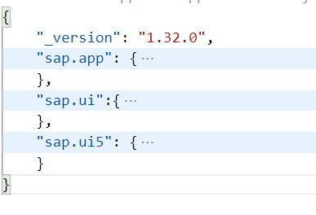
Hands – on: Create the manifest.json file
Now we will create the manifest.json file in our webapp folder.
Along with that we have to create the i18n folder and in that folder a i18n.properties file.
Then we have to add the required code to these file.
Also link the manifest to the Component.js file.
Code Links:
manifest.json
i18n.properties
Component.js

Slide 7
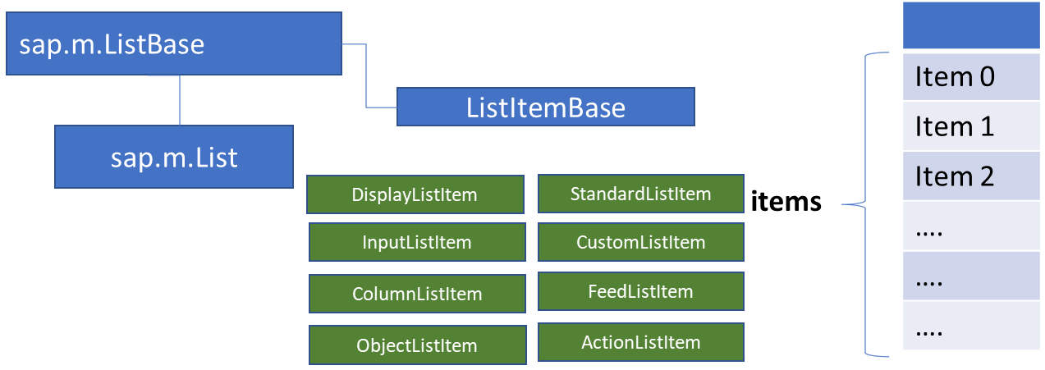
List Control
The list contains various list items. These items can be of various types depending on the use case and on the content they have. SAPUI5 already provides the most common list items in SAP Fiori in the form of controls, although custom list items can also be created if necessary.
Reference: https://sapui5.hana.ondemand.com/#/entity/sap.m.List
A List control is a single column table with multiple items inside. We will have a list header and items as aggregation.

Slide 8
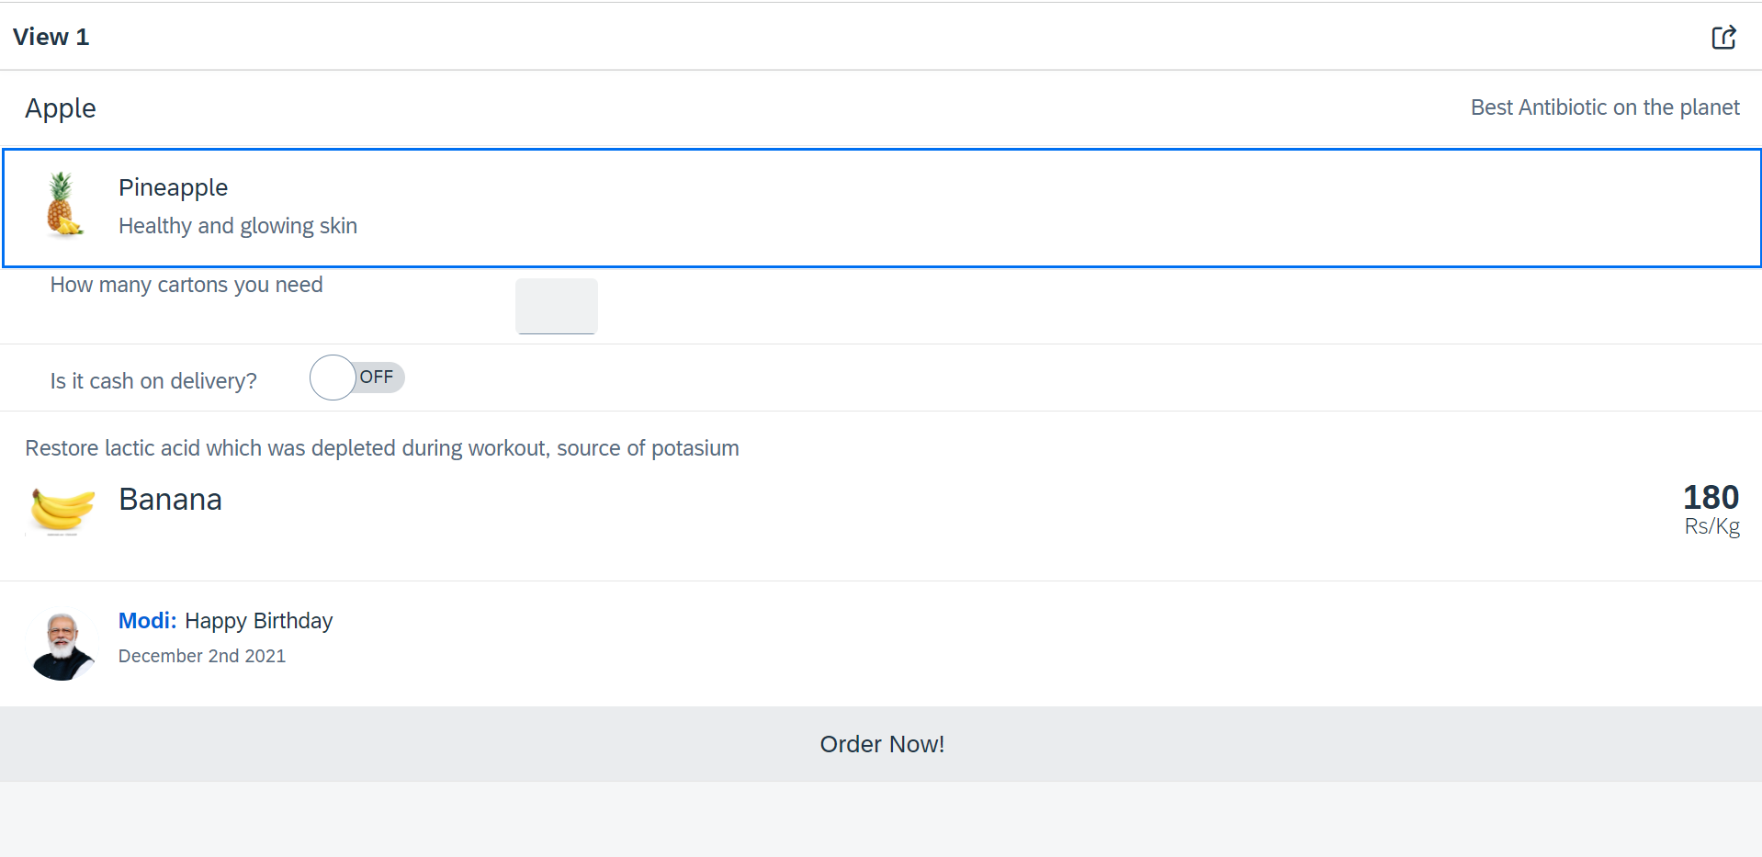
Hands – on: List Controls in UI5
Now we will add some basics list controls in the View1 of our application.
Code Links:
View1.view.xml

Slide 9
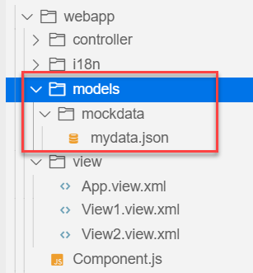
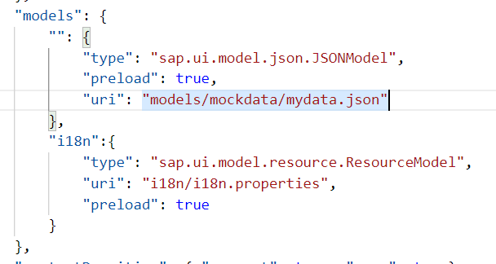
Hands – on: Models in manifest.json
Now we want to bind our list control to a model to show the multiple records using the list control.
For this first we need a file with some demo data related to the fruits, so we have created a file which has three entity sets:
fruits – name, color, type (neutral, citrus, alkaline),price, healthBenefit, unit, status (available, discontinued, out of stock), image (url from google) – 20
cities – name, state, famousFor, population – 10
supplier – name, city, country, contactPerson, phone, email, sinceWhen – 10
Now we will create a models folder in the webapp and in the models folder we will create a folder named mockdata, we will put our json file in this folder.
Code Link:
manifest.json
mydata.json
View1.view.xml

Slide 10
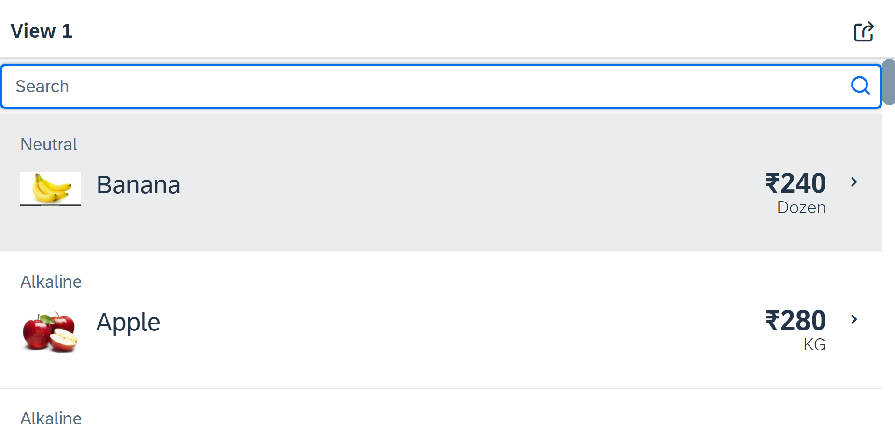
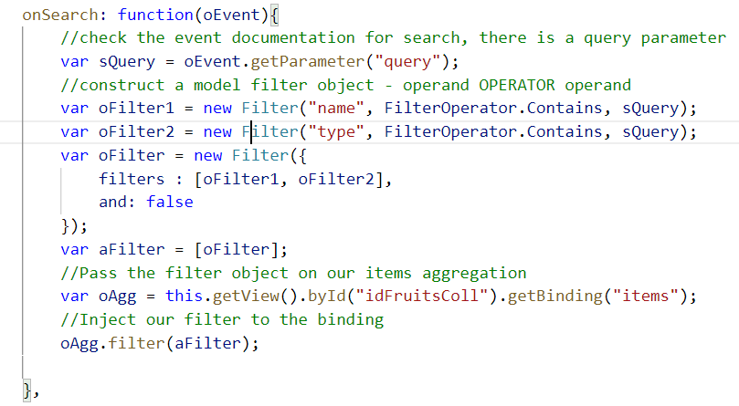
Hands – on: Search Functionality
Nowadays we come across many web pages that provide data in the form of lists or tables. These lists are enabled with search functionality, i.e., as the user types in into the search field and press enter then the data in the list is filtered according to the value in search field.
Code Link:
View1.view.xml
View1.controller.js

Slide 11
List Modes
The mode property defines the appearance of the left area of a list item.
Lists have properties and events and they contain list items that inherit from sap.m.ListItemBase, which provides navigation, selection and event features.
Delete
SingleSelect
01
04
only one list item can be deleted via provided delete button
Right-positioned single selection mode (only one list item can be selected).
01
04
MultiSelect
You can edit this text
SingleSelectLeft
02
05
02
more than one list item can be selected
05
Left-positioned single selection mode (only one list item can be selected).
03
06
None
03
06
SingleSelectMaster
no selection
Selected item is highlighted but no selection control is visible (only one list item can be selected).

Slide 12
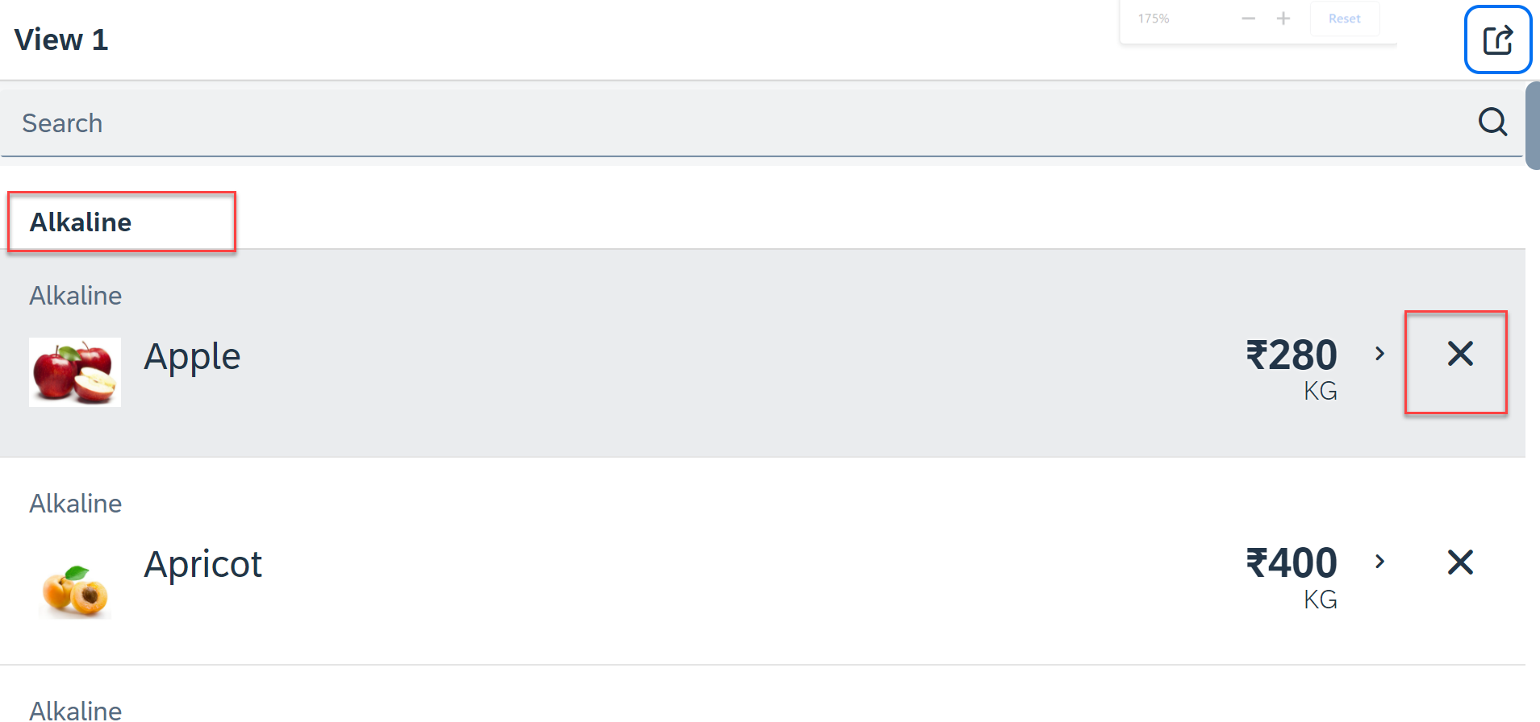
Hands – on: List modes and Grouping
Now we will look at the different type of List mode provided by the UI5.
Along with that we will Implement the Press event, Selection change and Delete Event in the List Control.
Also we will Group the data according to the type of Fruit.
Code Link:
View1.view.xml
View1.controller.js

Slide 13
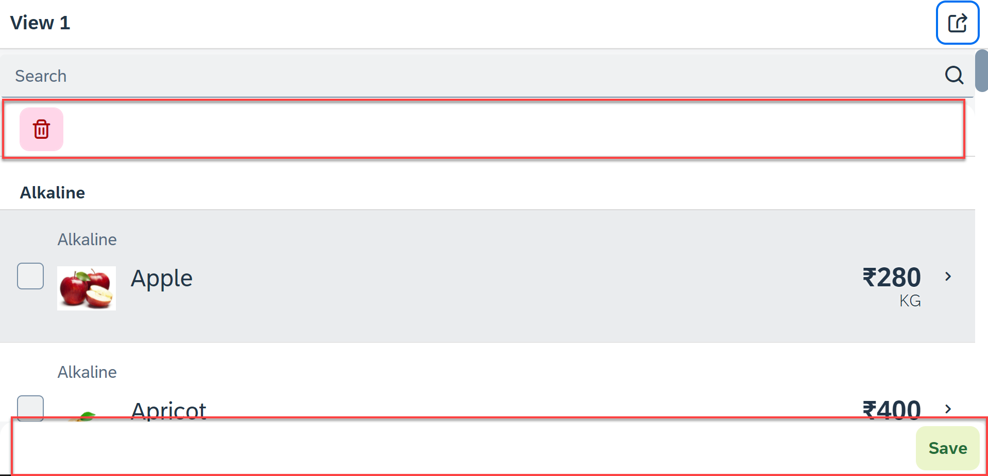
Hands – on: Header and Footer Toolbar
Now we will add a Header Toolbar to the list control and in that we will add a delete button to delete multiple items from the List.
We will also add a Footer toolbar to the page control and in that we will add a save button on press of the save button a alert will be shown to the user.
Code Link:
View1.view.xml
View1.controller.js

Slide 14
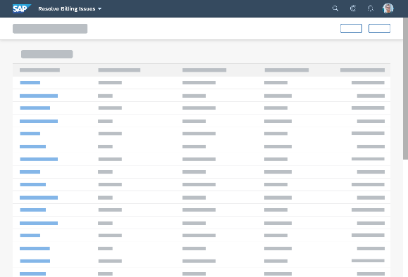
Introduction to Worklist Application
A worklist displays a collection of items a user needs to process. Working through the list usually involves reviewing details of the items and taking action. In most cases, the user has to either complete a work item or delegate it.
When to use:
Users have numerous work items and need to decide which ones to process first.
You want to give users a direct entry point for taking action on work items.
Users need to work with multiple views of the same content (for example, items that are “Open”, “In Process”, or “Completed”). You want to offer tabs for switching between views.
Detail View
List Page

Slide 15
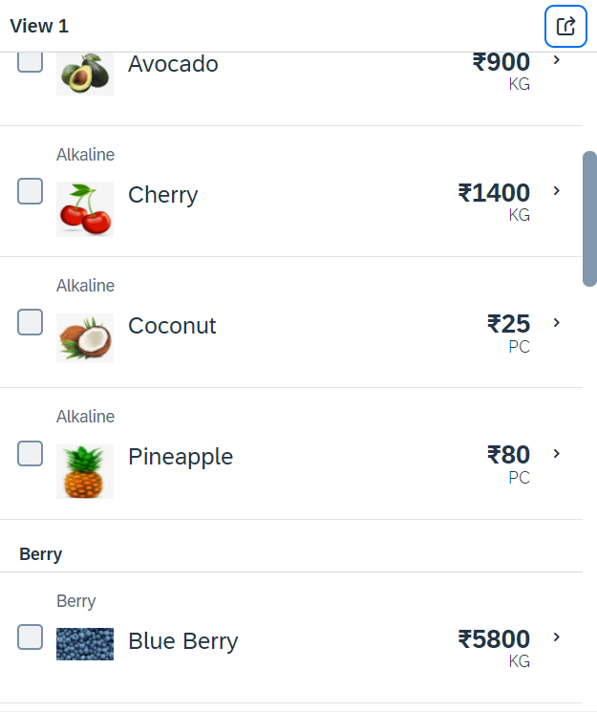
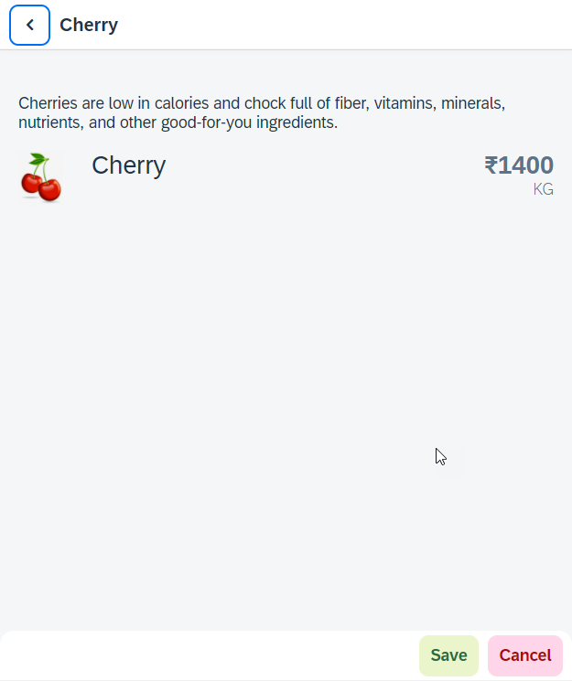
Hands – on: Worklist App
Now we will make our application a worklist app. On selecting the fruit on the View1 navigate to the View2 and show the details of that the selected fruit on it.
For this we have to modify the onSelectItem Function to get the path of the selected item and pass it in the onNext function.
Code Link:
View1.view.xml
View1.controller.js
View2.view.xml

Slide 16
SplitApp Container Control
A split app container control will divide our app into 2 parts, 1st is called master section and 2nd is called detail section. It is used to fully optimize the screen width for desktop apps.
SplitApp Container
masterPages
detailPages
App Container
View1
View2
View1
View2

Slide 17
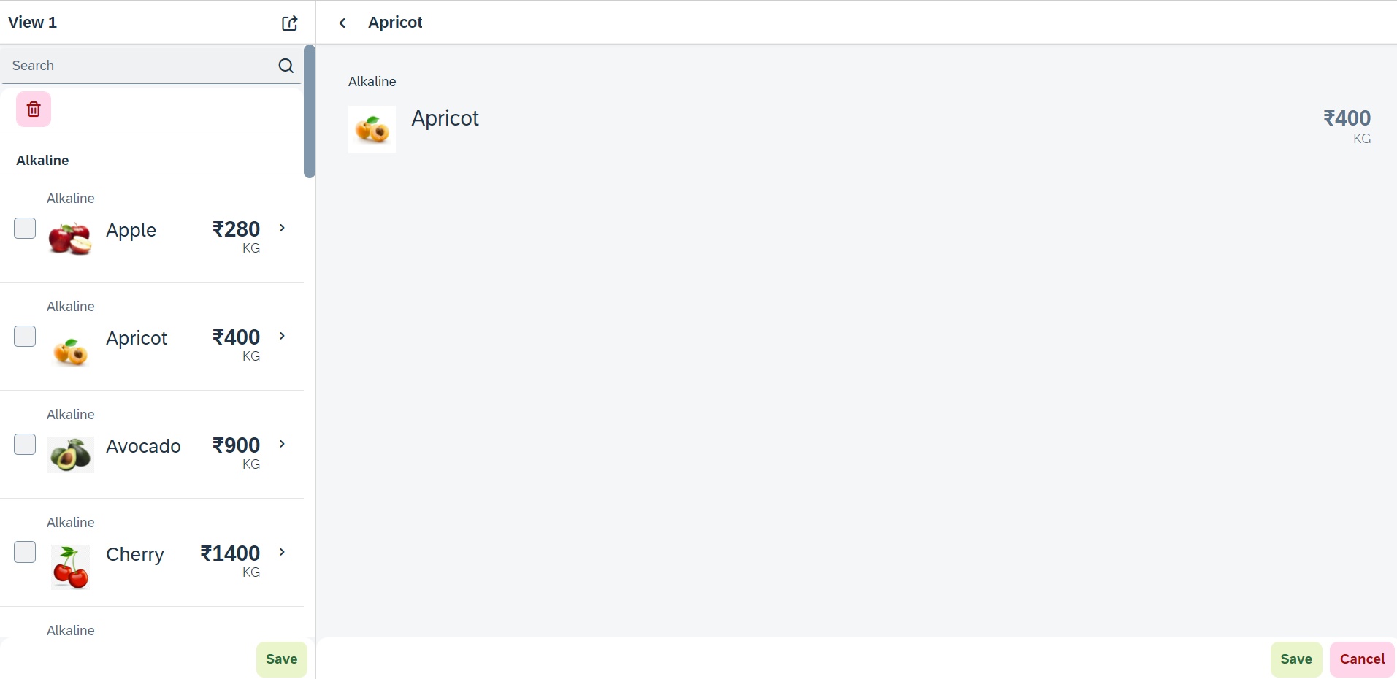
Hands – on: SplitApp (Mater Detail App)
Now we will convert our worklist app to a master detail application.
Once we change the app container, we have to change the method of getting the view object in onNext function.
Code Links:
App.view.xml
Component.js
View1.controller.js

Slide 18
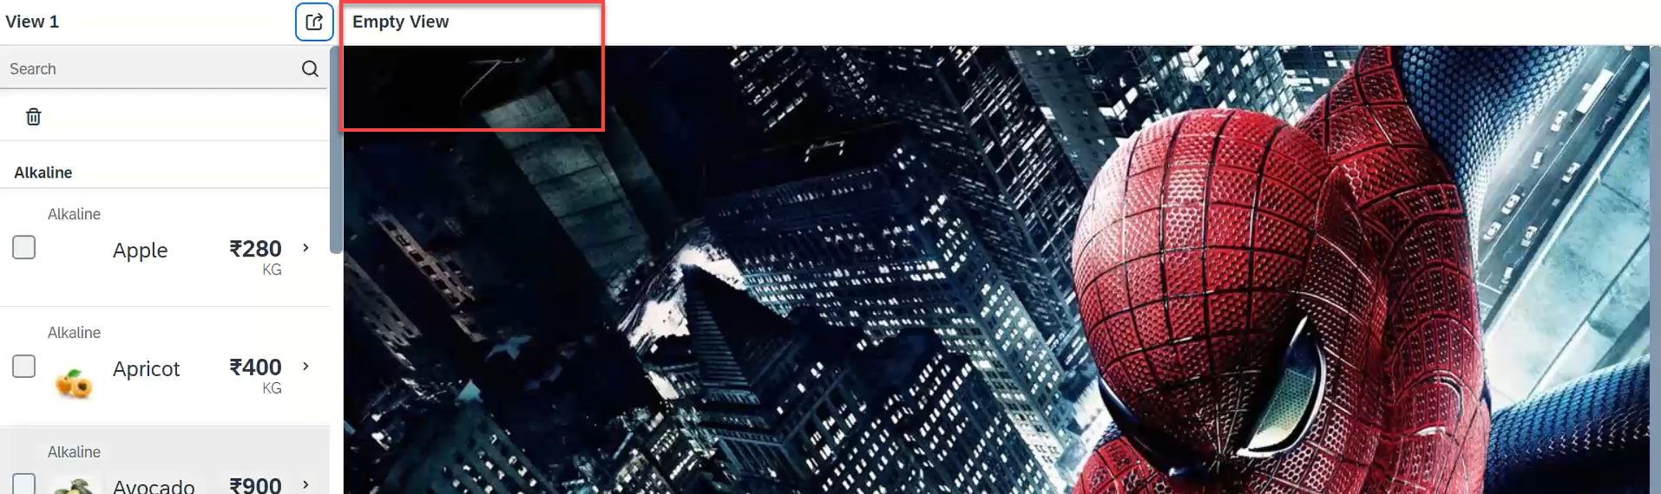
Hands – on: Empty View at start
Now we want to load an Empty view in the detail section when our application starts.
To do this first we need to create one Empty View and Empty controller.
After we need to add the Empty view to the Split App container in the Component.js file.
oAppCon.addMasterPage(oView1).addDetailPage(oEmpty).addDetailPage(oView2);
Code Link:
Empty.view.xml
Empty.controller.js
Component.js
View1.controller.js
This view will be loaded by default

Slide 19

Common Issues in our Fiori App
We have used sap.ui.view API to create the object of the view, but it seems that the API is obsolete. Then what is the right way to instantiate our view?
All the view objects are instantiated when app starts, whether we want or not. If user does not navigate to a view, still the view object is getting created. This is a misuse of computation power and slow down our app when number of views are increased/high.
For each view, we are writing more and more code to create object, multiple developers will add this code in different place, because of this the maintenance will be come very expensive even the handover will be very hard.
The browser navigation button (back) is not working properly.
When the refresh of app happens, the application should restore the state of the UI. It should not start all over again. So user will not frustrate applying all the filters again.
When we take a URL of the page and share with colleagues/friends/family, when they open same URL, Eventually they should see the same state of application what I see. Basically we should restore the state of UI as it is in our system.
Router

Slide 20
Router
Router is an object which is provided by SAP UI5 Component (UIComponent).
It is responsible for creating our view objects on demand.
It is also responsible for complete app navigation based on pattern (end point, hash tag).
How to use router:
Get the router object form the UIComponent class.
Call initialize method using the object
The initialize method will SCAN manifest.json to find the routing configuration (mandatory).
Add the routing configuration in manifest.json
rootView – base view we want to load
config – base configuration like view type, path of all views etc.
routes – array of all the targets, patterns and route names
targets – put all the end point target with views which needs to be instantiated and nav.
Sap.m.routing.Router is the class used for Routing and Navigation purpose in SAP UI5 framework.
“Pattern” defines the hashtag that needs to be added at the end of the URL when it is hit.
“name” defines a unique name for the particular route.
“target” defines the target which is defined in targets section

Slide 21
Routing Configuration
Routing Configuration is defined in manifest.json file. It is defined under the “sap.ui5” section.
Routing configuration consists of routes, targets, config, and owner.
rootView
config
routes
targets
This section contains the information about our Root View. The View which works as a container for other views. In this section we provide the path of the view, type and controlId.
This section contains the global router configuration and default values that apply for all routes and targets. We define the router class that we want to use and where our views are located in the app.
Each route defines a name, a pattern, and one or more targets to navigate to when the route has been hit.
Three subsections :-
1. pattern
2. name
3. target
A target defines a view that is or more routes displayed, it is associated with one.
Subsections: -
Overview
detail

Slide 22
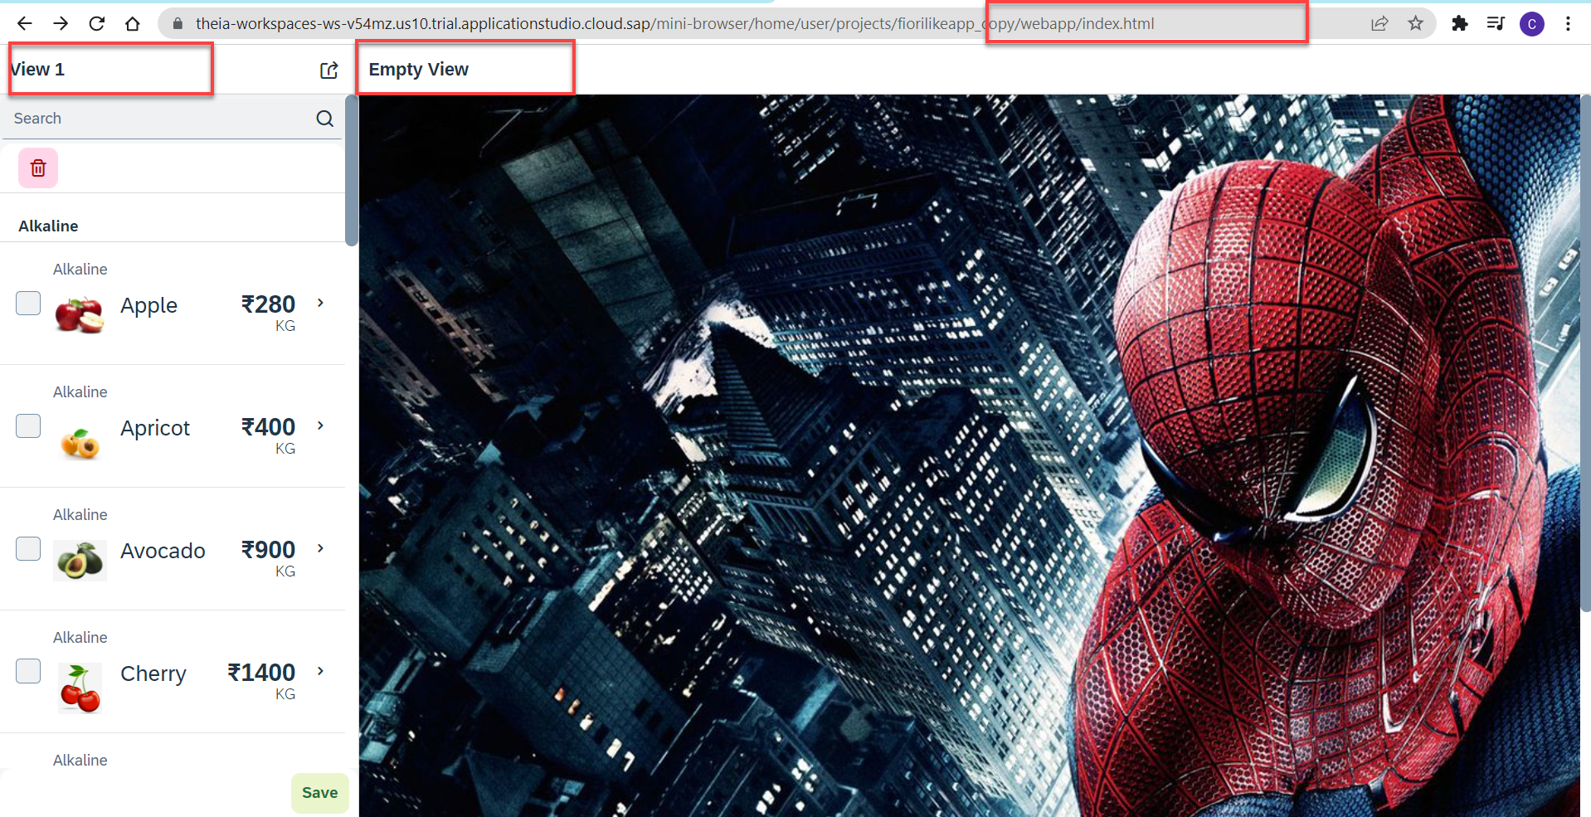
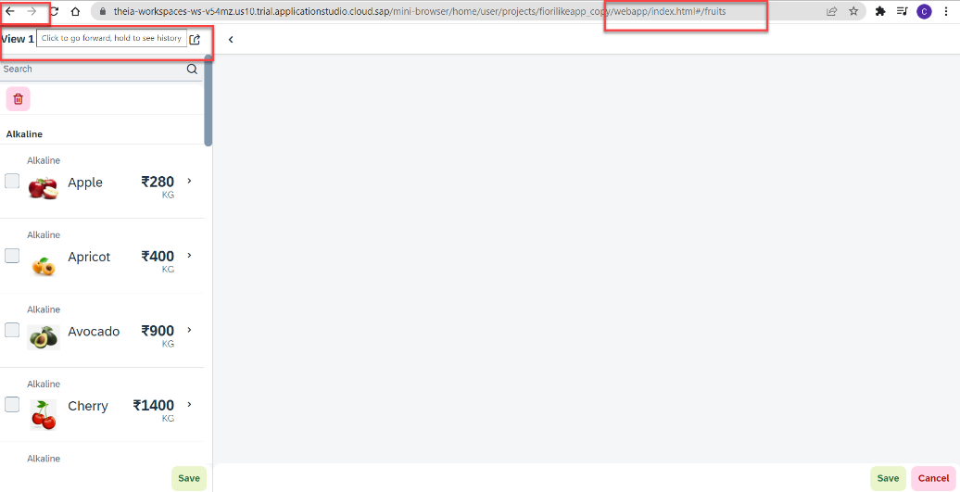
Hands – on: Routing Implementation
Now we need to implement routing in our existing application, for that we have to follow the Steps provided in the previous slides.
We also have to change the navigation in our View1 controller, and make it according to the Router, for that we have to get the router object in the View1 controller and then navigate to the view using the navTo() function.
To get the router object in View1 controller
this.oRouter = this.getOwnerComponent().getRouter();
To navigate to the View2
this.oRouter.navTo("loadMyV2");
Code Links:
manifest.json
Component.js
View1.controller.js

Slide 23
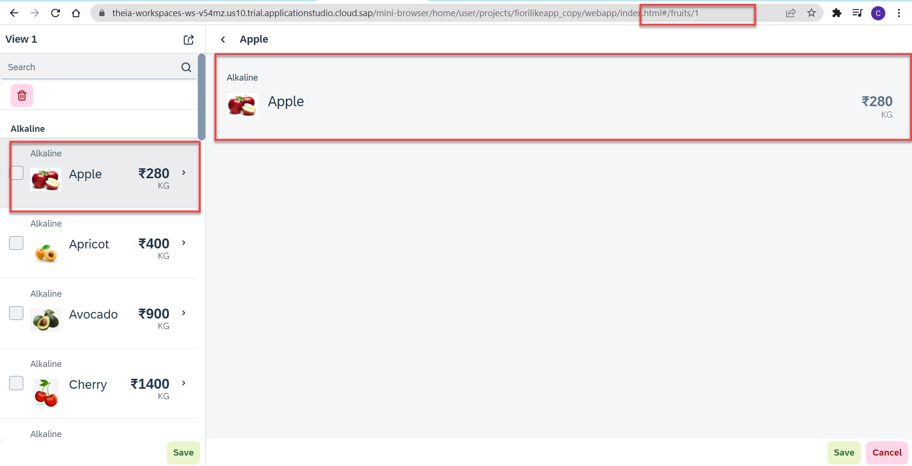
Hands – no: Route Match Handler
Route Match Handler: It is a function which gets triggered every time when Route, End Point, Hash Tag Changes.
Now using the route match handler we will load the data of the selected fruit.
Code Link:-
View1.controller.js
View2.controller.js
manifest.js

Slide 24

End of Day 8

Slide 25

Questions

Slide 26

Shekhar Vedi

Slide 27


We’re committed to empower you to be
Most Desirable Resource
through powerful training solutions.
We build the workforce of the future.
250+
Corporate Clients
30,000+
Learners Trained
25000+
Learners Placed
FREE WEBINARS
Sign up for free webinars with industry experts every fortnight!
Enroll Now!
Contact us today!
https://anubhavtrainings.com/

Slide 28




More from AnubhavTrainings.com

Slide 29
Title
Content

